Slide 1
TRANSACTION MANAGEMENT:
Deadlock

Slide 2
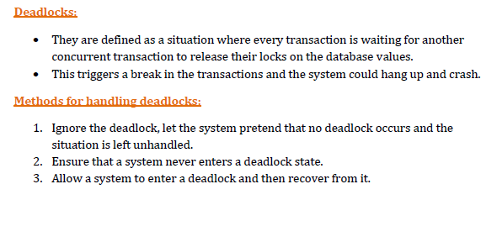

Slide 3
Causes of deadlock:
1. Mutual exclusion : only 1 transaction can lock a database value at a given time.
2. Hold and wait : a transaction which has locked a database value is waiting to acquire additional database value which are being held by other concurrent transaction.
3. No pre – emption : a database value can be released voluntarily by a transaction holding it after it has completed its processing or in case it gets aborted.
4. Circular wait : there exists a set of transactions T1, T2, T3 such that T1 is waiting for a database value which is locked by T2, T2 is waiting for a database value which is locked by T3 and T3 in turn is waiting for a database value locked by T1.

Slide 4
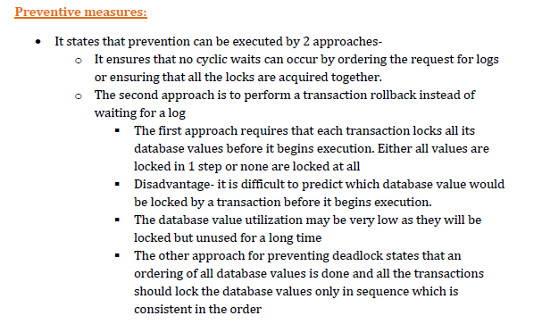
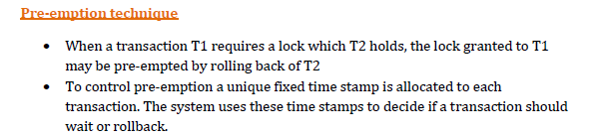

Slide 5
Deadlock detection and recovery
• An algorithm that examines the state of system regularly needs to be invoked to check if a deadlock occurs. If a deadlock occurs the system must recover from it.
• The most common method is to rollback one or more transactions to break the deadlock.
• It involves 3 steps.
  Selection of victim‐ given a set of deadlock transactions the system determines which transaction to rollback and break the deadlock. Generally the transaction that will incur minimum cost is rolled back.
  Rollback‐Once it is decided which transaction is to be rolled back the system must then determine how far that transaction must be rolled back‐either total or partial.
  Starvation‐In a system where the selection of a victim is based on cost factor it may happen that the same transaction is always picked up as a victim. As a result this transaction never completes its life cycle.
Hence the system must ensure that a transaction is picked as a victim only for a finite no of times.

